Slide 1

Dart Basics: Variables, Data Types & Conditional Statements
Dive into the fundamental building blocks of Dart programming, exploring how to manage data and control program flow.

Slide 2
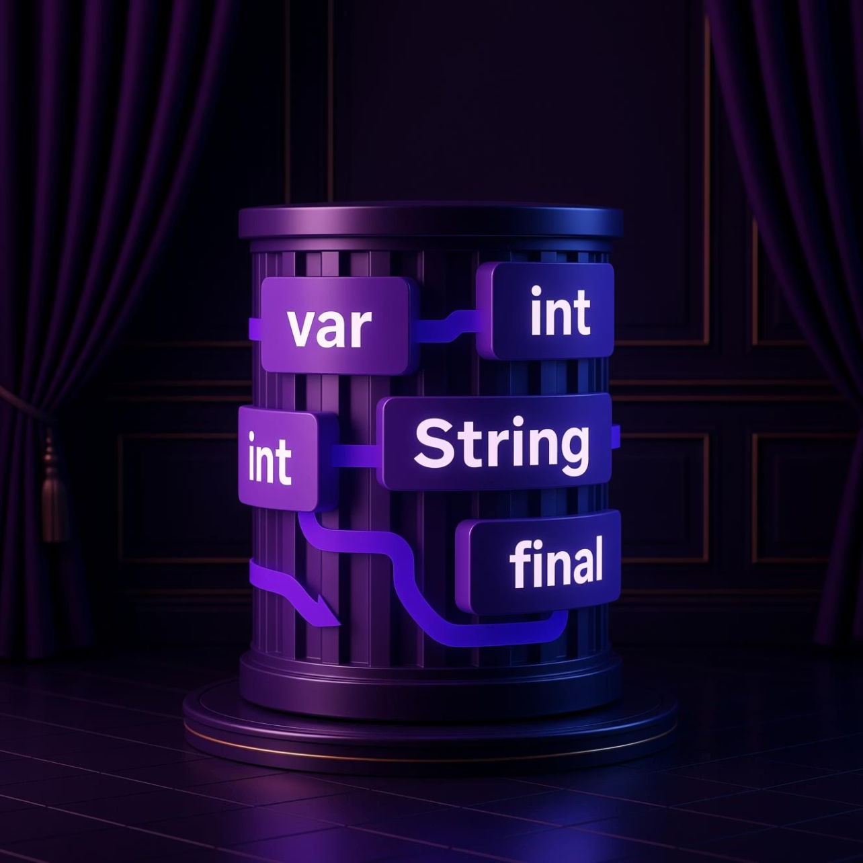
Understanding Variables in Dart
Variables are essential containers in programming, used to store data values. In Dart, each variable has a specific data type that determines what kind of data it can hold.
You can declare variables in several ways:
var: Allows Dart to infer the type based on the initial value. This is flexible but less explicit.
Explicit Types: Directly specify the data type (e.g., int, String) for clarity and type safety.
final / const: Used for constants, where final is set once at runtime and const is a compile-time constant.
int age = 25;var name = 'Alice';final PI = 3.14;

Slide 3

Common Dart Data Types with Examples
int
double
String
For storing whole numbers without decimal points.
For storing numbers with decimal points, representing fractional values.
For storing sequences of characters (text), enclosed in single or double quotes.
int count = 10;
double price = 19.99;
String greeting = 'Hello';
bool
List & Map
For storing boolean values: either true or false.
Dart also provides powerful collection types like List (ordered sequence) and Map (key-value pairs) for more complex data structures.
bool isActive = true;

Slide 4

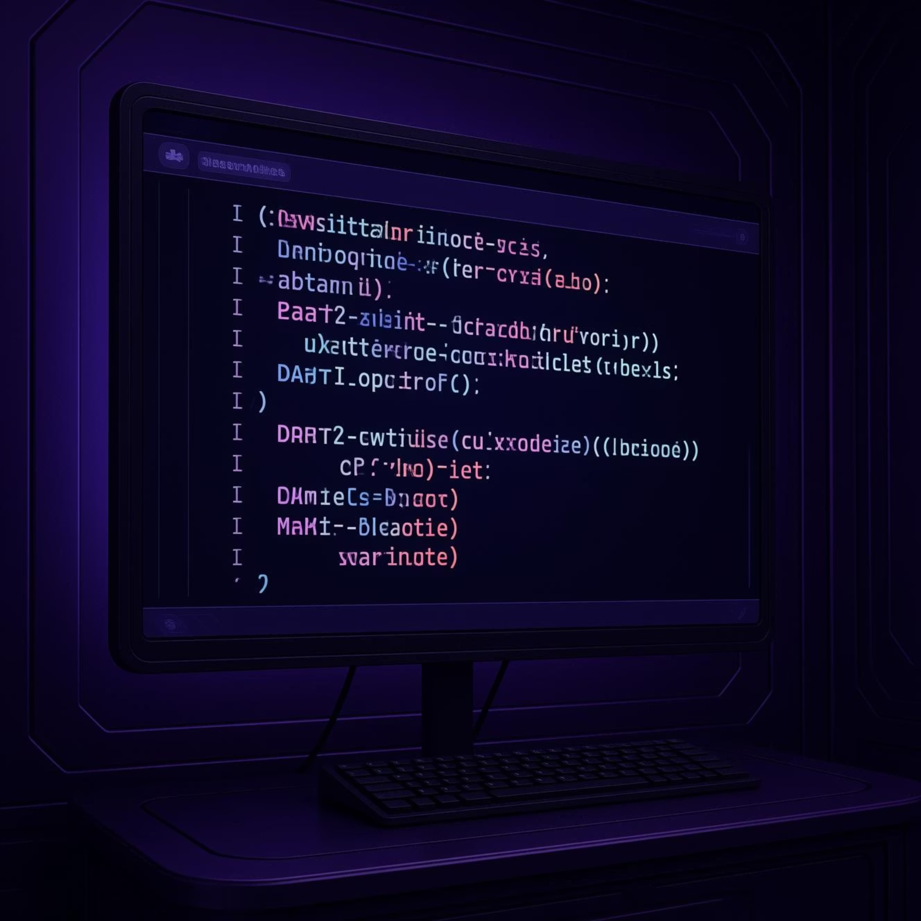
Conditional Statements: Directing Program Flow
Conditional statements allow your program to make decisions and execute different blocks of code based on certain conditions.
If-Else Statements
Switch Statements
The if statement evaluates a boolean expression. If it's true, the code inside the if block executes. An optional else block handles the false condition.
A switch statement is used to perform different actions based on different conditions, often when you have multiple possible values for a single variable.
int temperature = 25;
if (temperature > 30) {
print('It's hot!');
} else if (temperature > 20) {
print('It's warm.');
} else {
print('It's cool.');
}
String day = 'Monday';
switch (day) {
case 'Monday':
print('Start of the week.');
break;
case 'Friday':
print('Weekend is near!');
break;
default:
print('Midweek.');
}

